Slide 1
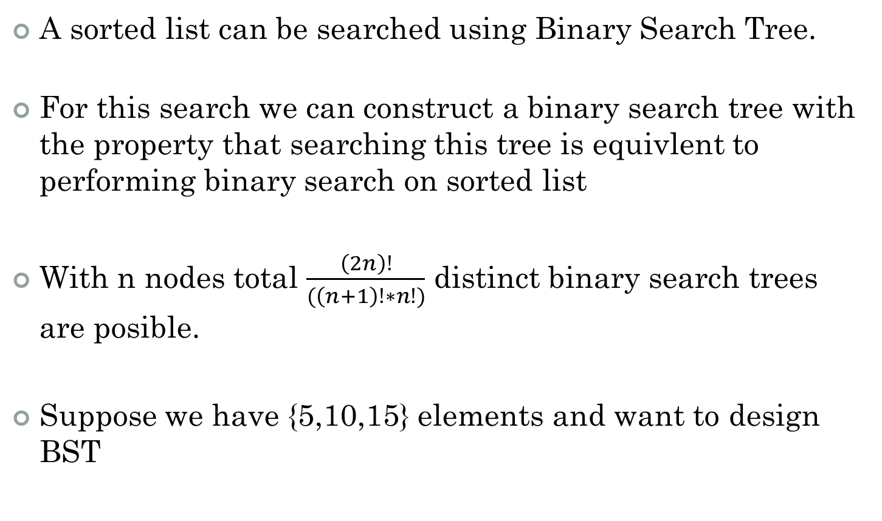
Optimal Binary Search Trees
A sorted list can be searched using Binary Search Tree.
For this search we can construct a binary search tree with the property that searching this tree is equivlent to performing binary search on sorted list
With n nodes total $\frac{\left(2n\right)!}{(\left(n+1\right)!∗n!)}$ distinct binary search trees are posible.
Suppose we have {5,10,15} elements and want to design BST

Slide 2
5
15
10
10
(i) (ii)
(v) (iv) (iii)
15
5
15
5
10
5
15
5
15
10
10

Slide 3
Comparisons
Searching→ | 5 | 10 | 15 | Average
For i tree | 1 | 2 | 3 | 2
For ii tree | 3 | 2 | 1 | 2
For iii tree | 2 | 1 | 2 | <2
For iv tree | 1 | 3 | 2 | 2
For v tree | 2 | 3 | 1 | 2

Slide 4
Successful and Unsuccessful Search
In analysis of BST we need to consider both successful and unsuccessful searches.
In representation of BST, these successful searches are represented by circles and unsuccessful searches are represented by squares
10
5
15
e1
e2
e3
e4

Slide 5
Successful and Unsuccessful Search
Each time a BST is examined for an identifier that is not in the tree, the search terminates at an external node.
Since all such searches are unsuccessful searches, external nodes are also called as failure nodes .
BST with added external nodes is called as Extended Binary Tree

Slide 6
Successful and Unsuccessful Search
Lets expect different elements to be searched for different frequencies.
That is 5→ p1, 10→p2 and 15→p3 and also as there are n+1 external nodes assume their search frequencies as q0,q1,q2 and q3.
Therefore total no of comparisons in searching for tree iii is =
2(p1)+p2+2(p3)+2(q0)+2(q1)+2(q2)+2 q3
Then can we calculate cost of a tree??

Slide 7
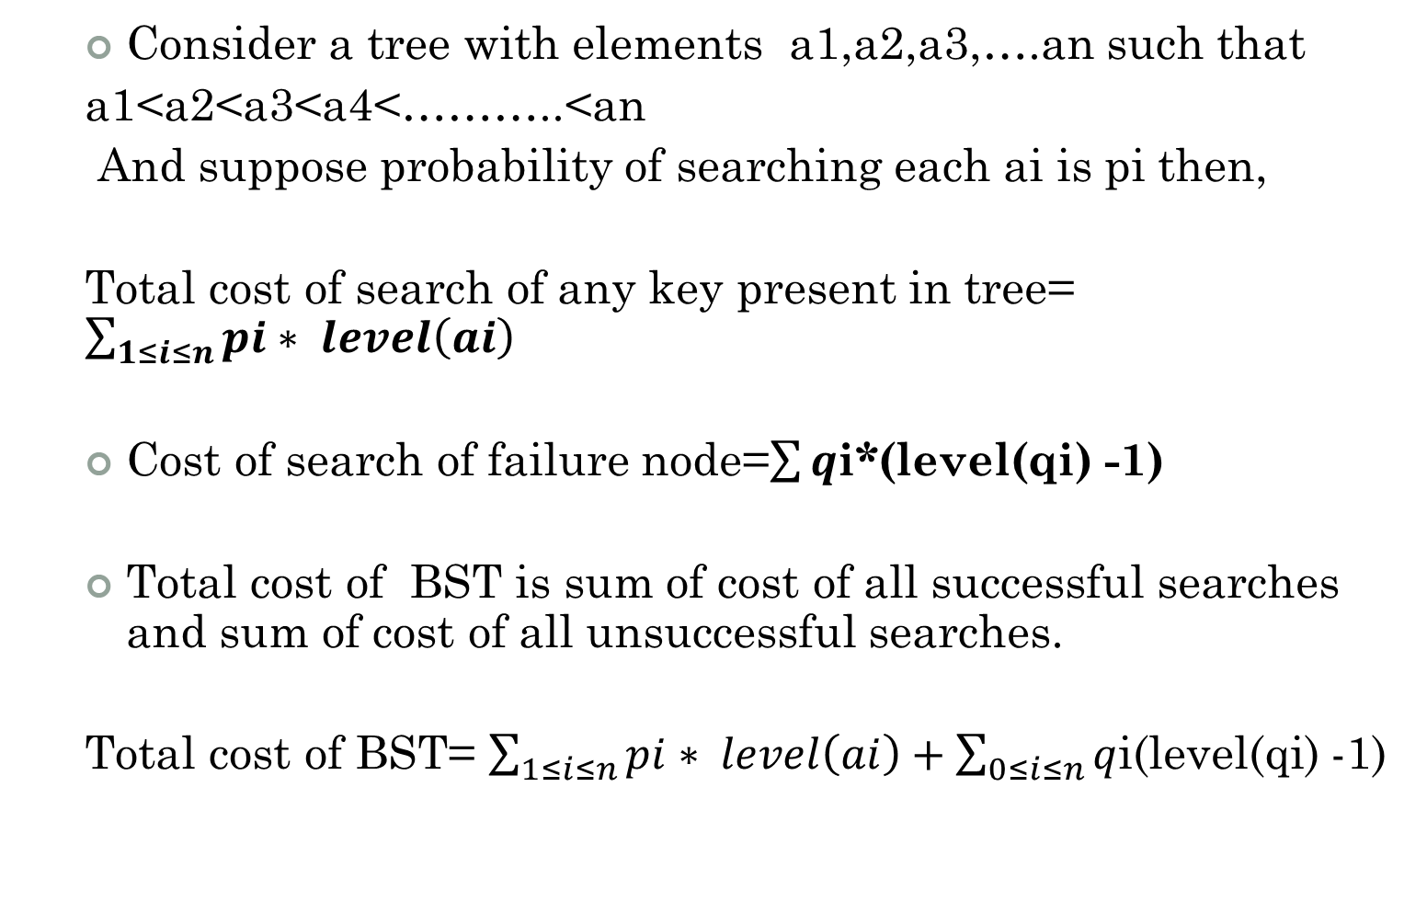
Cost of tree
Consider a tree with elements a1,a2,a3,….an such that
a1<a2<a3<a4<………..<an
And suppose probability of searching each ai is pi then,
Total cost of search of any key present in tree= $\sum_{1≤i≤n}{pi∗ level\left(ai\right)}$
Cost of search of failure node=$\sum{q}$i*(level(qi) -1)
Total cost of BST is sum of cost of all successful searches and sum of cost of all unsuccessful searches.
Total cost of BST= $\sum_{1≤i≤n}{pi∗ level\left(ai\right)+\sum_{0≤i≤n}{q}}$i(level(qi) -1)

Slide 8
Optimal Binary Search Trees
Given: n = 4
(a₁ a₂ a₃ a₄ ) = (do, if, int, while)
p(1: 4) = (3, 3 , 1, 1)
q(0: 4) = (2, 3, 1, 1, 1)

Slide 9
Optimal Binary Search Trees
we have
w(i, i) = q(i) →weight(i,j) ; sum of frequencies from i to j
c(i, i) = 0 → cost
r(i, i) = 0 → root
0 ≤ i ≤ 4, i < k ≤ j
w(i , j) = p( j ) + q( j ) + w( i, j-1)
c(i , j) = min {c( i , k-1) + c(k , j)} + w(i , j),
i < k ≤ j
r(i , j) is value of k that minimizes c(i , j)

Slide 10
Optimal Binary Search Trees
w( 0, 0) = q(0) = 2 c(0,0) = 0 r(0,0) = 0
w( 1, 1) = q(1) =3 c(1,1) = 0 r(1,1) = 0
w( 2, 2) = q(2) = 1 c(2,2) = 0 r(2,2) = 0
w( 3, 3) = q(3) = 1 c(3,3) = 0 r(3,3) = 0
w( 4, 4) = q(4) = 1 c(4,4) = 0 r(4,4) = 0

Slide 11
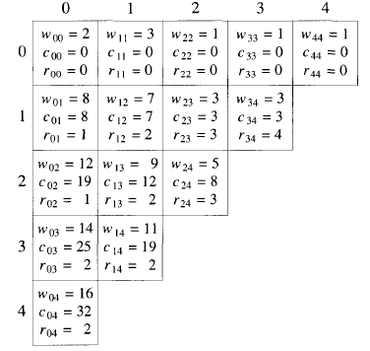

Slide 12
Optimal Binary Search Trees
i =0, j=1, k=1
w(0 , 1) = p(1 ) + q( 1 ) + w( 0, 0)
= 3 + 3 + 2
= 8
c(0 , 1) = min {c( 0 , 0) + c(1 ,1)} + w(0 , 1)
= min {0 +0} + 8
= 8
r(0, 1) = k =1

Slide 14
Optimal Binary Search Trees
i =1, j=2, k=2
w(1 , 2) = p(2 ) + q( 2 ) + w( 1, 1)
= 3 + 1 + 3
= 7
c(1 , 2) = min {c( 1 , 1) + c(2 ,2)} + w(1 , 2)
= min {0 +0} + 7
= 7
r(1, 2) = k =2

Slide 16
Optimal Binary Search Trees
i =2, j=3, k=3
w(2 , 3) = p(3 ) + q( 3 ) + w( 2, 2)
= 1 + 1 + 1
= 3
c(2 , 3) = min {c( 2 , 2) + c(3 ,3)} + w(2 , 3)
= min {0 +0} + 3
= 3
r(2, 3) = k =3

Slide 18
Optimal Binary Search Trees
i =3, j=4, k=4
w(3 , 4) = p(4 ) + q( 4 ) + w( 3, 3)
= 1 + 1 + 1
= 3
c(3 , 4) = min {c( 3 , 3) + c(4 ,4)} + w(3 , 4)
= min {0 +0} + 3
= 3
r(3, 4) = k =4

Slide 20
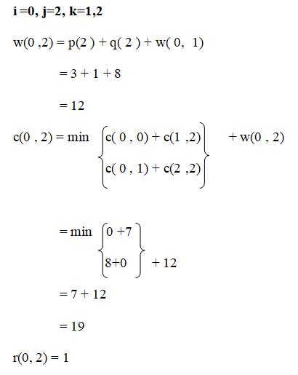
Optimal Binary Search Trees

Slide 22
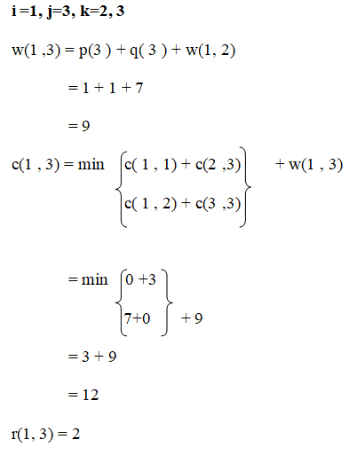
Optimal Binary Search Trees

Slide 23
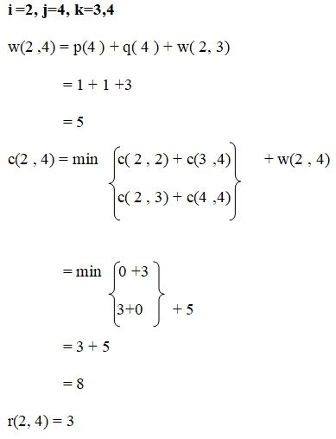
Optimal Binary Search Trees

Slide 24
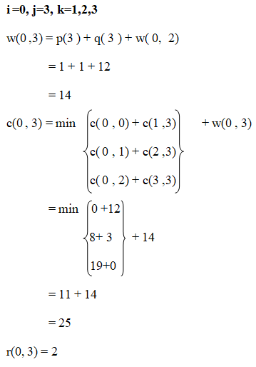
Optimal Binary Search Trees

Slide 25
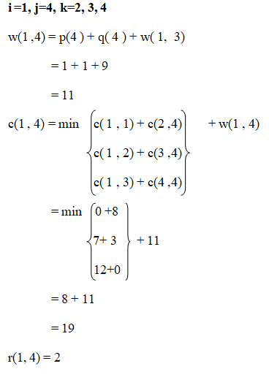
Optimal Binary Search Trees

Slide 26
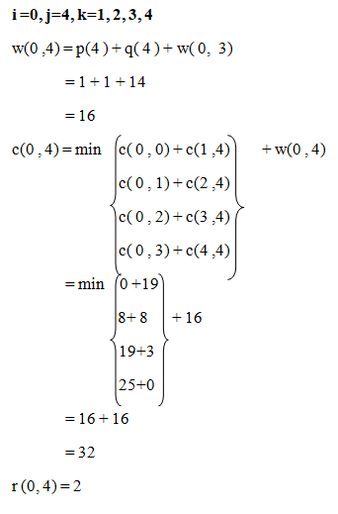
Optimal Binary Search Trees

Slide 27
Optimal Binary Search Trees

Slide 28
Optimal Binary Search Trees
2
1
3
4

Slide 29
Optimal Binary Search Trees
if
do
int
while

Slide 30
Height Balance Trees

Slide 31

Balanced binary tree
The disadvantage of a binary search tree is that its height can be as large as N-1
This means that the time needed to perform insertion and deletion and many other operations can be O(N) in the worst case
We want a tree with small height
A binary tree with N node has height at least (log N)
Thus, our goal is to keep the height of a binary search tree O(log N)
Such trees are called balanced binary search trees.
Examples are AVL tree, red-black tree.

Slide 32



Binary Search Tree - Best Time
All BST operations are O(h), where d is tree depth
minimum d is h log₂N for a binary tree with N nodes
So, best case running time of BST operations is O(log N)

Slide 33
Binary Search Tree - Worst Time
Worst case running time is O(N)
What happens when you Insert elements in ascending order?
Insert: 2, 4, 6, 8, 10, 12 into an empty BST
Problem: Lack of “balance”:
compare depths of left and right subtree
Unbalanced degenerate tree

Slide 34
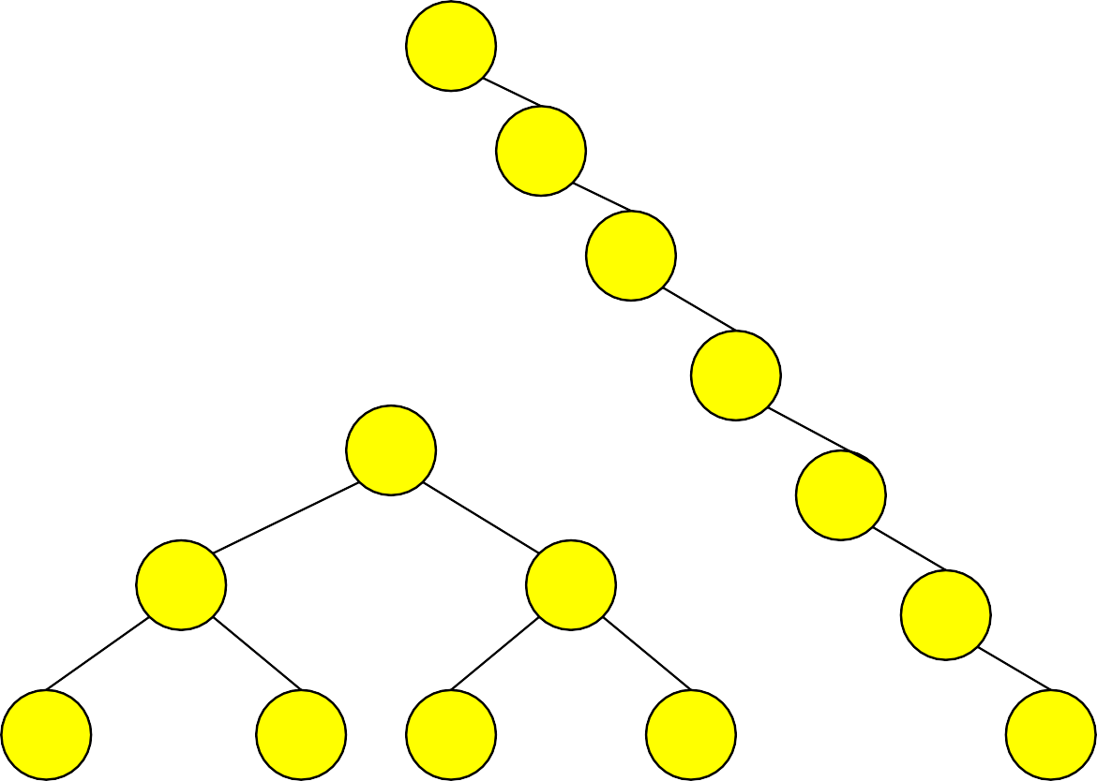
Balanced and unbalanced BST
1
4
2
2
5
3
1
3
4
4
Is this “balanced”?
5
2
6
6
1
3
5
7
7

Slide 35
Balancing Binary Search Trees
Many algorithms exist for keeping binary search trees balanced
Adelson-Velskii and Landis (AVL) trees (height-balanced trees)
Splay trees and other self-adjusting trees
B-trees and other multiway search trees

Slide 36
AVL Tree is…
Named after Adelson-Velskii and Landis
The first dynamically balanced trees to be propose
Binary search tree with balance condition in which the sub-trees of each node can differ by at most 1 in their height

Slide 37
Definition of a balanced tree
Every node must have left & right sub-trees of the same height

Slide 38
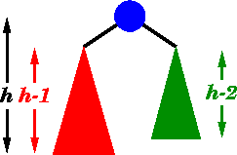
An AVL tree has the following properties:
Sub-trees of each node can differ by at most 1 in their height
Every sub-trees is an AVL tree

Slide 39
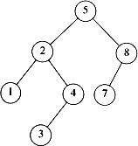
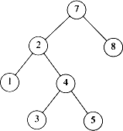
AVL tree?
YES
Each left sub-tree has height 1 greater than each right sub-tree
NO
Left sub-tree has height 3, but right sub-tree has height 1

Slide 40
AVL tree
Height of a node
The height of a leaf is 1. The height of a null pointer is zero.
The height of an internal node is the maximum height of its children plus 1
Note that this definition of height is different from the one we defined previously (we defined the height of a leaf as zero previously).

Slide 41
AVL Trees
10
10
5
20
5
20
3
43
3
1
2
1
3

Slide 42
AVL Trees
12
8
16
4
10 14
2
6

Slide 43



AVL Tree
-1
0
0
0
-1
1
0
0
0
0
AVL Tree
-2
AVL Tree
1
0
0
-1
0
Not an AVL Tree

Slide 44
AVL Trees : Balance Factor
AVL trees are height-balanced binary search trees
Balance factor of a node
height(right subtree) - height(left subtree)
An AVL tree has balance factor calculated at every node
For every node, heights of left and right subtree can differ by no more than 1
Store current heights in each node

Slide 45
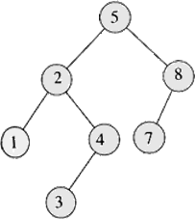
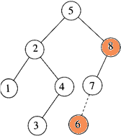
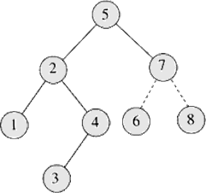
Insertion
Insert 6
Imbalance at 8 Perform rotation with 7

Slide 46
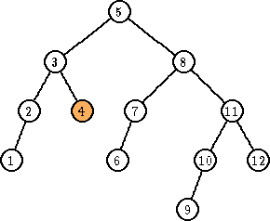
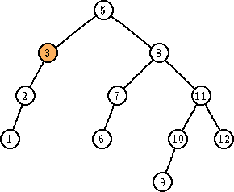
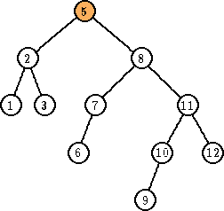
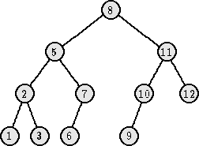
Deletion
Delete 4
Imbalance at 3 Perform rotation with 2
Imbalance at 5 Perform rotation with 8

Slide 47
Key Points
AVL tree remain balanced by applying rotations, therefore it guarantees O(log N) search time in a dynamic environment
Tree can be re-balanced in at most O(log N) time

Slide 48
Searching AVL Trees
Searching an AVL tree is exactly the same as searching a regular binary tree
all descendants to the right of a node are greater than the node
all descendants to the left of a node are less than the node

Slide 49
Inserting in AVL Tree
Insertion is similar to regular binary tree
keep going left (or right) in the tree until a null child is reached
insert a new node in this position
an inserted node is always a leaf to start with
Major difference from binary tree
must check if any of the sub-trees in the tree have become too unbalanced
search from inserted node to root looking for any node with a balance factor of 2

Slide 50
Inserting in AVL Tree
A few points about tree inserts
the insert will be done recursively
the insert call will return true if the height of the sub-tree has changed
since we are doing an insert, the height of the sub-tree can only increase
if insert() returns true, balance factor of current node needs to be adjusted
balance factor = height(right) – height(left)
left sub-tree increases, balance factor decreases by 1
right sub-tree increases, balance factor increases by 1
if balance factor equals 2 for any node, the sub- tree must be rebalanced

Slide 51
Inserting in AVL Tree
M(-1)
M(0)
insert(V)
E(1)
P(0)
E(1)
P(1)
J(0)
J(0)
V(0)
M(-1)
M(-2)
insert(L)
E(1)
P(0)
E(-2)
P(0)
J(0)
J(1)
L(0)
This tree needs to be fixed!

Slide 52
Re-Balancing a Tree
To check if a tree needs to be rebalanced
start at the parent of the inserted node and journey up the tree to the root
if a node’s balance factor becomes 2 need to do a rotation in the sub-tree rooted at the node
once sub-tree has been re-balanced, guaranteed that the rest of the tree is balanced as well
can just return false from the insert() method
4 possible cases for re-balancing
only 2 of them need to be considered
other 2 are identical but in the opposite direction

Slide 53

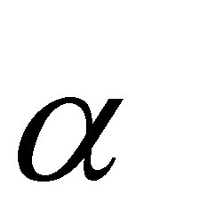
Insertions in AVL Trees
Let the node that needs rebalancing be
There are 4 cases:
Outside Cases (require single rotation) :
Insertion into left subtree of left child of
Insertion into right subtree of right child of
Inside Cases (require double rotation) :
Insertion into right subtree of left child of
Insertion into left subtree of right child of
The rebalancing is performed through four separate rotation algorithms.

Slide 54
j
AVL Insertion: Outside Case
Consider a valid AVL subtree
k
h
Z
h
h
X
Y

Slide 55
j
AVL Insertion: Outside Case
Inserting into X destroys the AVL property at node j
k
h
Z
h+1
h
Y
X

Slide 56
j
AVL Insertion: Outside Case
Do a “right rotation”
k
h
Z
h+1
h
Y
X

Slide 57
j
Single right rotation
Do a “right rotation”
k
h
Z
h+1
h
Y
X

Slide 58
Outside Case Completed
k
“Right rotation” done! (“Left rotation” is mirror
symmetric)
j
h+1
h
h
X
Y
Z
AVL property has been restored!

Slide 59
j
AVL Insertion: Inside Case
Consider a valid
AVL subtree
k
h
Z
h
h
X
Y

Slide 60
j
AVL Insertion: Inside Case
Inserting into Y destroys the AVL property at node j
Does “right rotation” restore balance?
k
h
Z
h
h+1
X
Y

Slide 61
k
AVL Insertion: Inside Case
“Right rotation” does not restore balance… now k is out of balance
j
h
X
h
h+1
Z
Y

Slide 62
j
AVL Insertion: Inside Case
Consider the structure of subtree Y…
k
h
Z
h
h+1
X
Y

Slide 63
j
AVL Insertion: Inside Case
Y = node i and subtrees V and W
k
h
h+1 Z
i
h
X
h or h-1
V
W

Slide 64
AVL Insertion: Inside Case
j
We will do a left-right
“double rotation” . . .
Z
k
i
X
V
W

Slide 65
Double rotation : first rotation
j
left rotation complete
i
Z
k
W
X
V

Slide 66
Double rotation : second rotation
j
Now do a right rotation
i
Z
k
W
X
V

Slide 67
Double rotation : second rotation
right rotation complete
i
Balance has been restored
k
j
h
h
h or h-1
X
V
W
Z

Slide 68
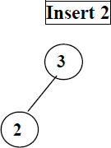
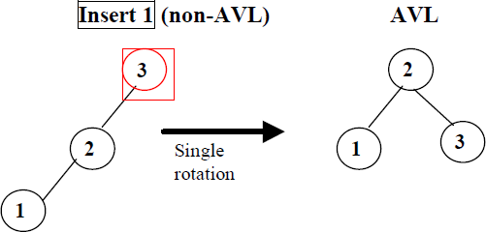

AVL Trees Example

Slide 69
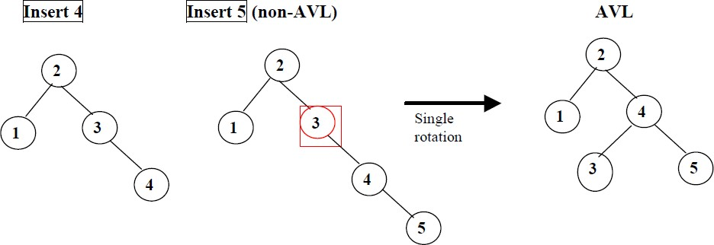
AVL Trees Example

Slide 70
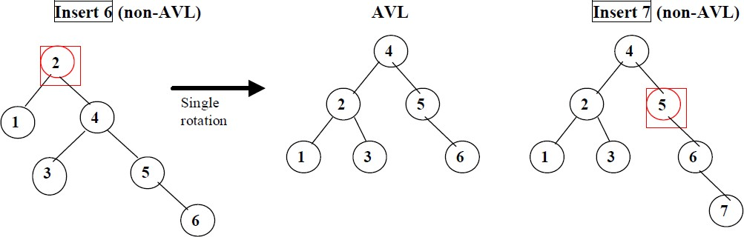
AVL Trees Example

Slide 71
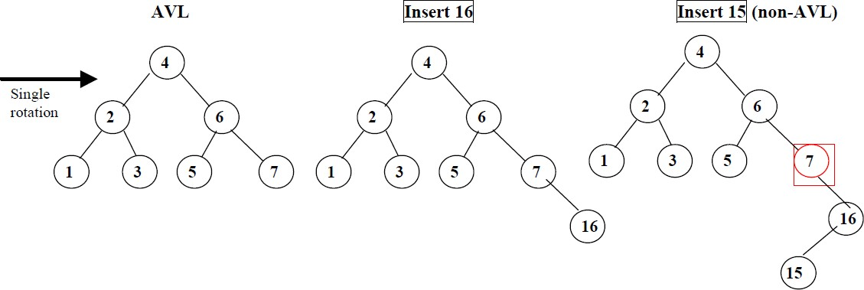
AVL Trees Example

Slide 72
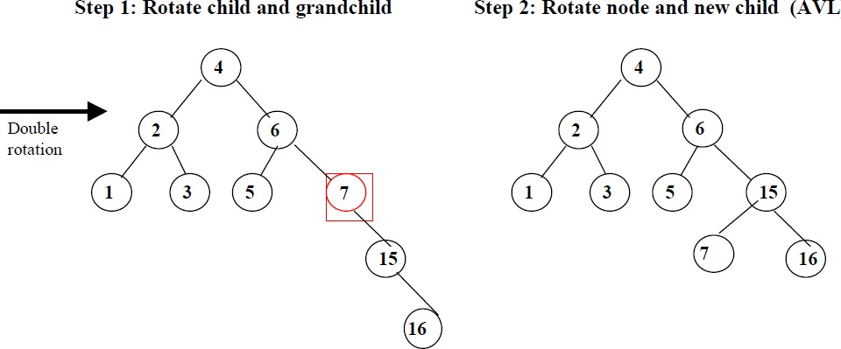
AVL Trees Example

Slide 73
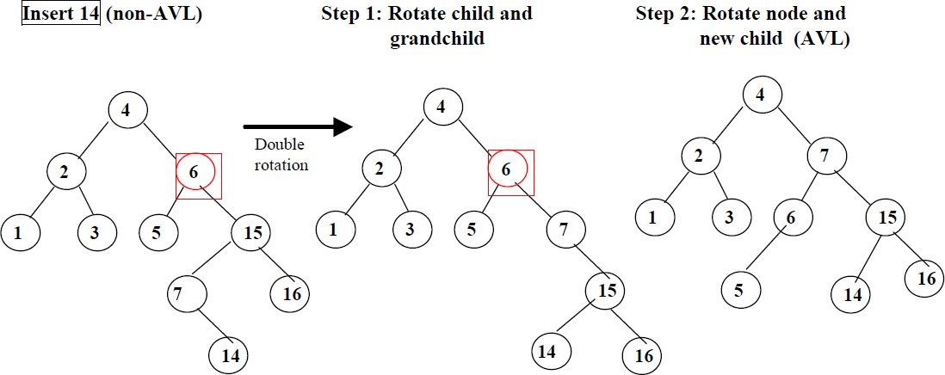
AVL Trees Example

Slide 74
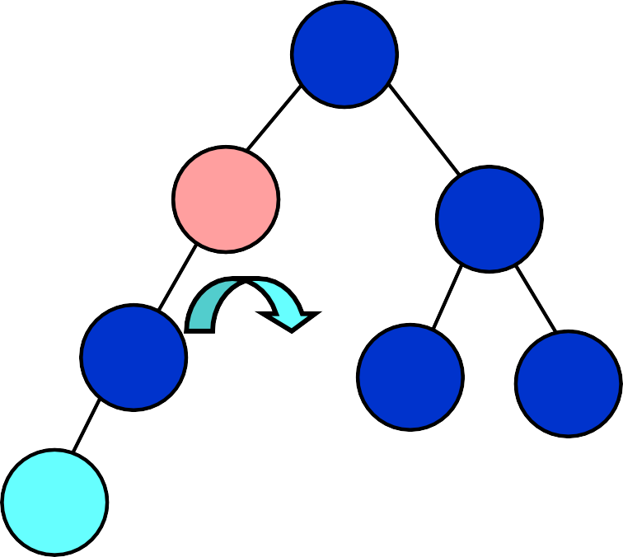
Example
Insert 3 into the AVL tree
11
11
8
20
4
20
4
16
27
3
8
16
27
3

Slide 75
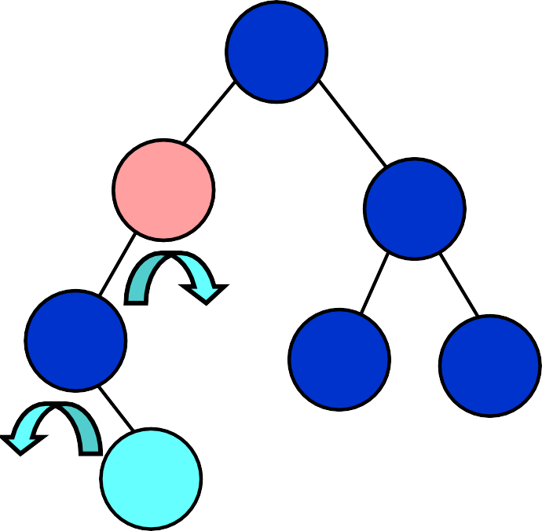
Example
Insert 5 into the AVL tree
11
11
8
20
5
20
4
16
27
4
8
16
27
5

Slide 76
AVL Trees: Exercise
Insertion order:
10, 85, 15, 70, 20, 60, 30, 50, 65, 80, 90, 40, 5, 55

Slide 77
Deletion X in AVL Trees
Deletion:
Case 1: if X is a leaf, delete X
Case 2: if X has 1 child, use it to replace X
Case 3: if X has 2 children, replace X with its inorder predecessor (and recursively delete it)
Rebalancing

Slide 78
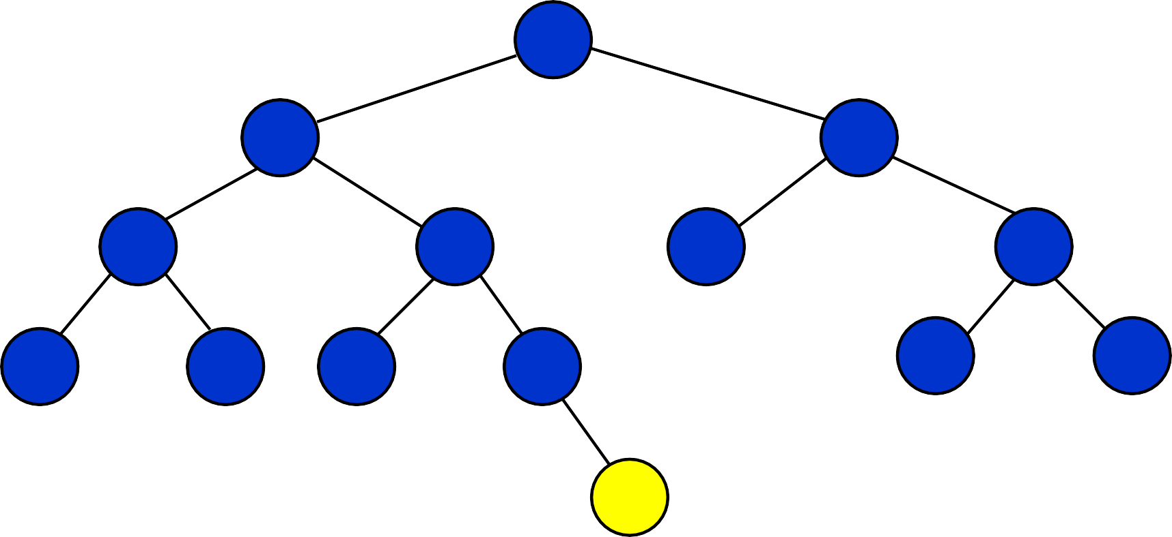
Delete 55 (case 1)
60
20
70
10
40
65
85
5
15
30
50
80
90
55

Slide 79
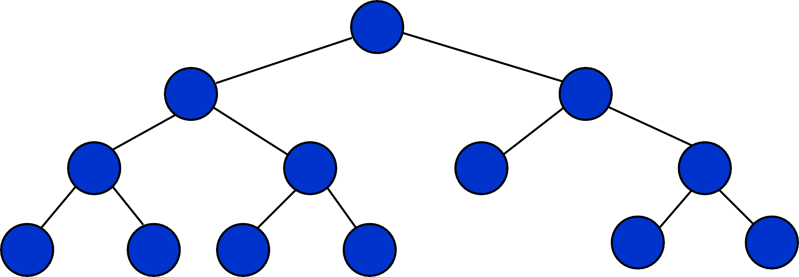
Delete 55 (case 1)
60
20
70
10
40
65
85
5
15
30
50
80
90
55

Slide 80
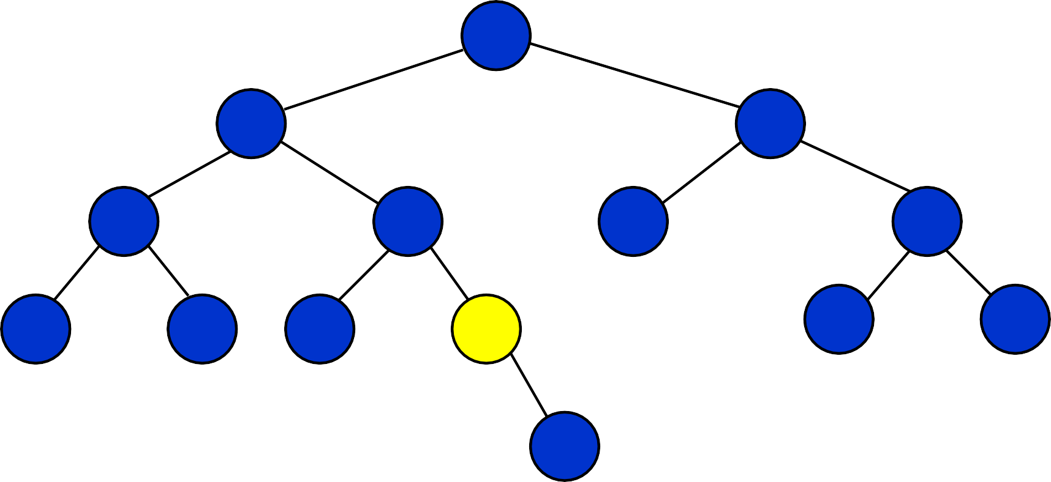
Delete 50 (case 2)
60
20
70
10
40
65
85
5
15
30
50
80
90
55

Slide 81
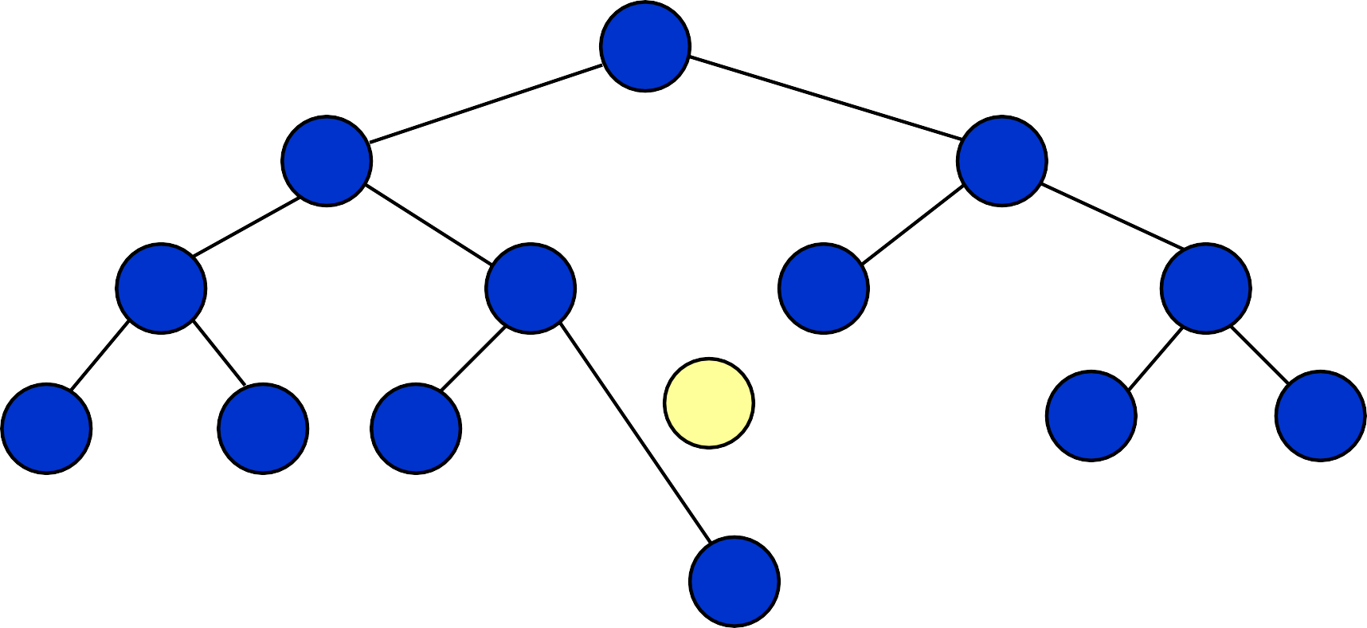
Delete 50 (case 2)
60
20
70
10
40
65
85
50
80
90
5
15
30
55

Slide 82
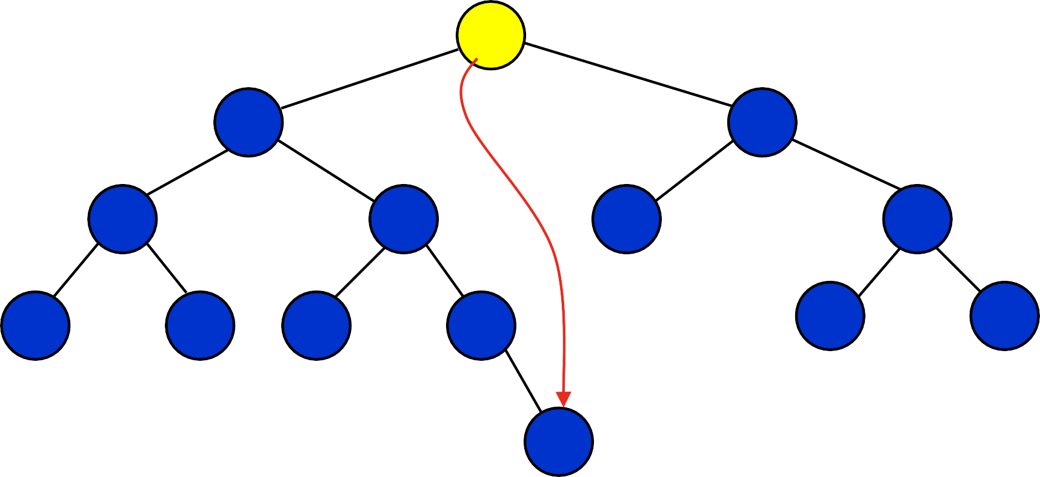
Delete 60 (case 3)
60
20
70
10
40
65
85
5
15
30
50
prev
80
90
55

Slide 83
Delete 60 (case 3)
55
20
70
10
40
65
85
5
15
30
50
80
90

Slide 84
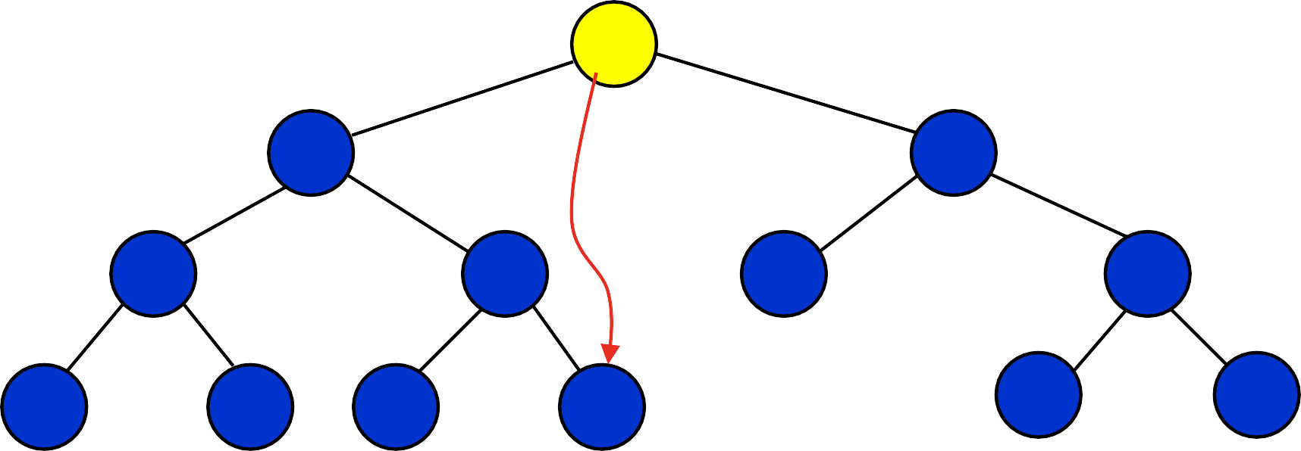
Delete 55 (case 3)
55
20
prev
70
10
40
65
85
5
15
30
50
80
90

Slide 85
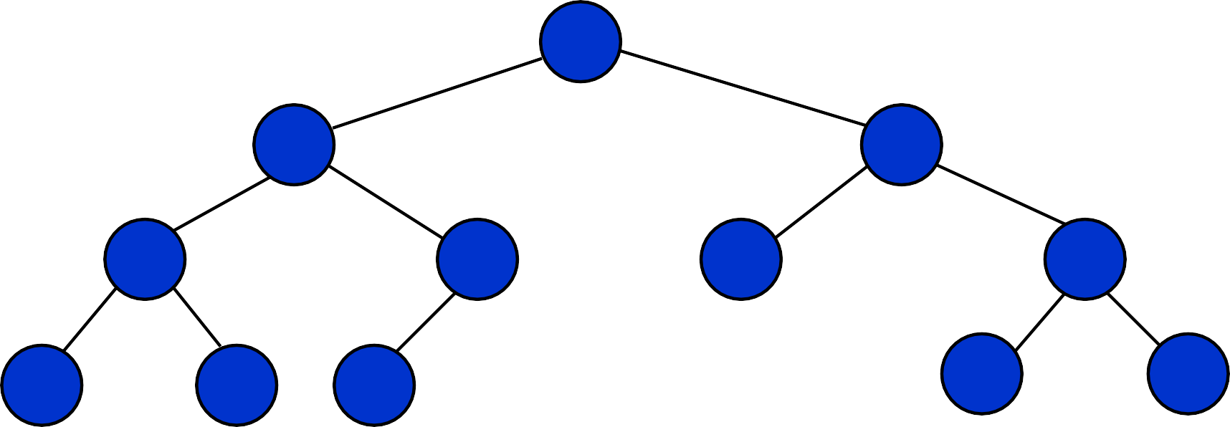
Delete 55 (case 3)
50
20
70
10
40
65
85
5
15
30
80
90

Slide 86
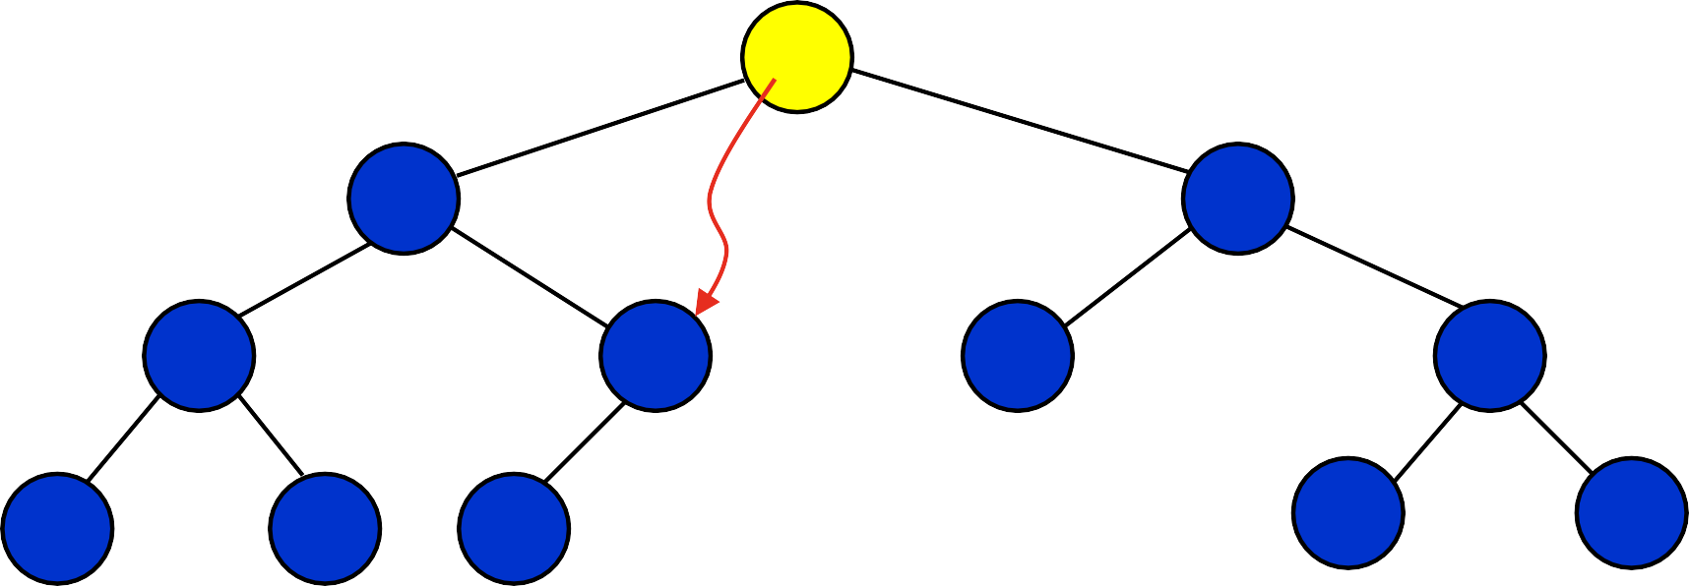
Delete 50 (case 3)
50
20
prev
70
10
40
65
85
5
15
30
80
90

Slide 87
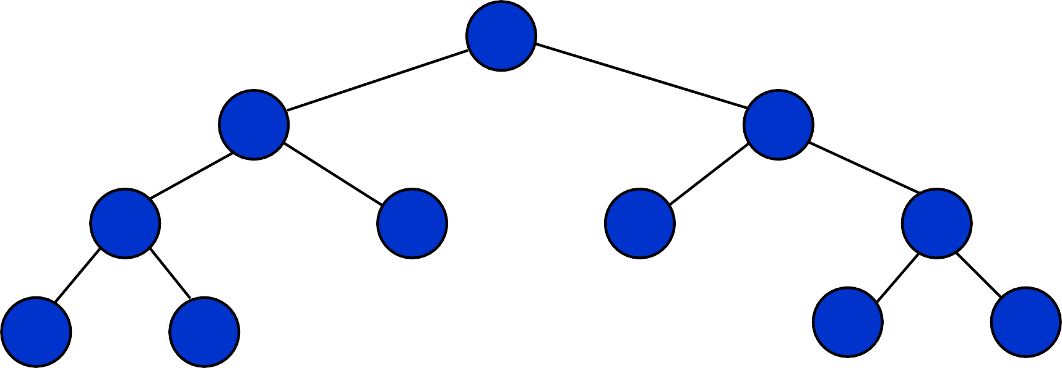
Delete 50 (case 3)
40
20
70
10
30
65
85
5
15
80
90

Slide 88
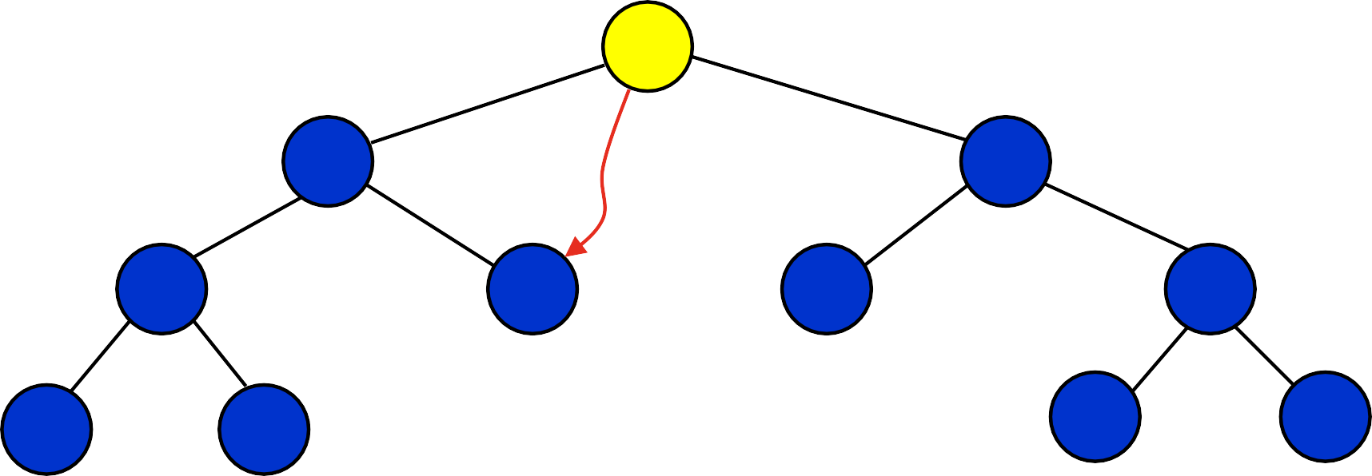
Delete 40 (case 3)
40
20
prev
70
10
30
65
85
5
15
80
90

Slide 89
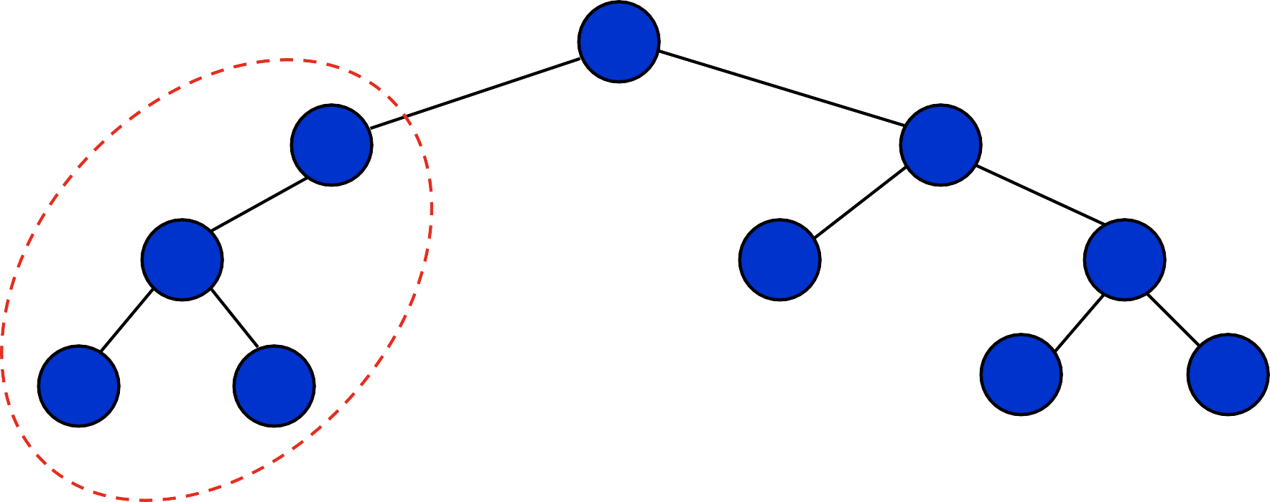
Delete 40 : Rebalancing
30
20
70
10
Case ?
65
85
5
15
80
90

Slide 90
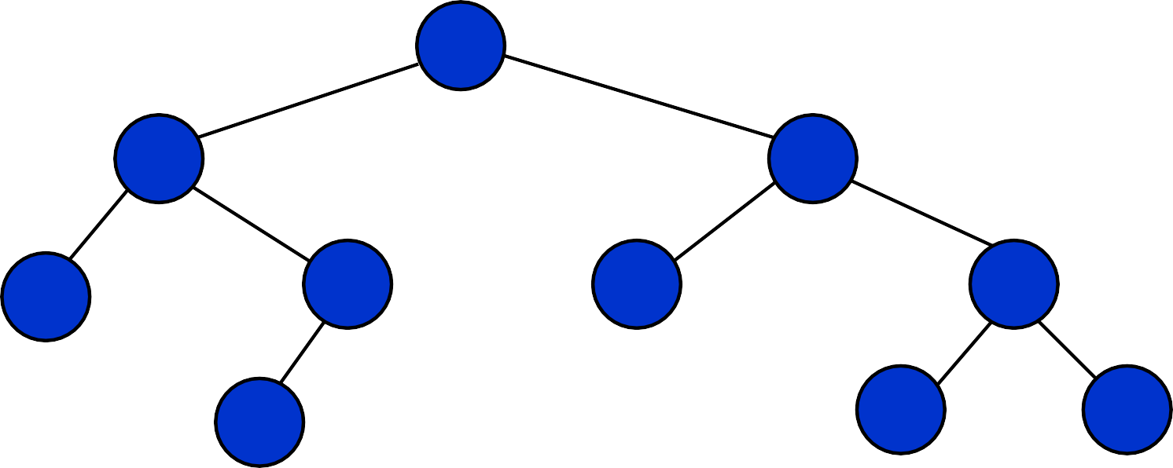
Delete 40: after rebalancing
30
10
70
5
20
65
85
15
80
90
Single rotation is preferred!

Slide 91
AVL Tree: analysis
The depth of AVL Trees is at most logarithmic.
So, all of the operations on AVL trees are also logarithmic.
The worst-case height is at most 44 percent more than the minimum possible for binary trees.

Slide 92
Red-Black Trees
“Balanced” binary search trees guarantee an O(log n) running time
Red-black-tree
Binary search tree with an additional attribute for its nodes: color which can be red or black
Constrains the way nodes can be colored on any path from the root to a leaf
Ensures that no path is more than twice as long as any other path

Slide 93
Example: RED-BLACK-TREE
26
17
41
NIL
NIL
30
47
38
NIL
50
NIL
NIL
NIL
NIL
NIL
For convenience we use a sentinel NIL[T] to represent all the NIL nodes at the leafs
NIL[T] has the same fields as an ordinary node
Color[NIL[T]] = BLACK

Slide 94
Red-Black-Trees Properties
(**Satisfy the binary search tree property**)
Every node is either red or black
The root is black
Every leaf (NIL) is black
If a node is red, then both its children are black
No two consecutive red nodes on a simple path from the root to a leaf
For each node, all paths from that node to descendant leaves contain the same number of black nodes

Slide 95
Black-Height of a Node
h = 4
bh = 2
26
h = 1
bh = 1
h = 3
bh = 2
17
41
NIL
NIL
h = 2
bh = 1
h = 2
bh = 1
30
47
h = 1
bh = 1
38
50
h = 1
bh = 1
NIL
NIL
NIL
NIL
NIL
NIL
Height of a node: the number of edges in the longest path to a leaf
Black-height of a node x: bh(x) is the number of black nodes (including NIL) on the path from x to a leaf, not counting x

Slide 96
Most important property of Red-Black-Trees
A red-black tree with n internal nodes has height at most 2log(n + 1)

Slide 97
Insertion in RB Trees
Insertion must preserve all red-black properties.
Should an inserted node be colored Red? Black?
Basic steps:
Use Tree-Insert from BST (slightly modified) to insert a node x into T.
Procedure RB-Insert(x).
Color the node x red.
Fix the modified tree by re-coloring nodes and performing rotation to preserve RB tree property.
Procedure RB-Insert-Fixup.

Slide 98
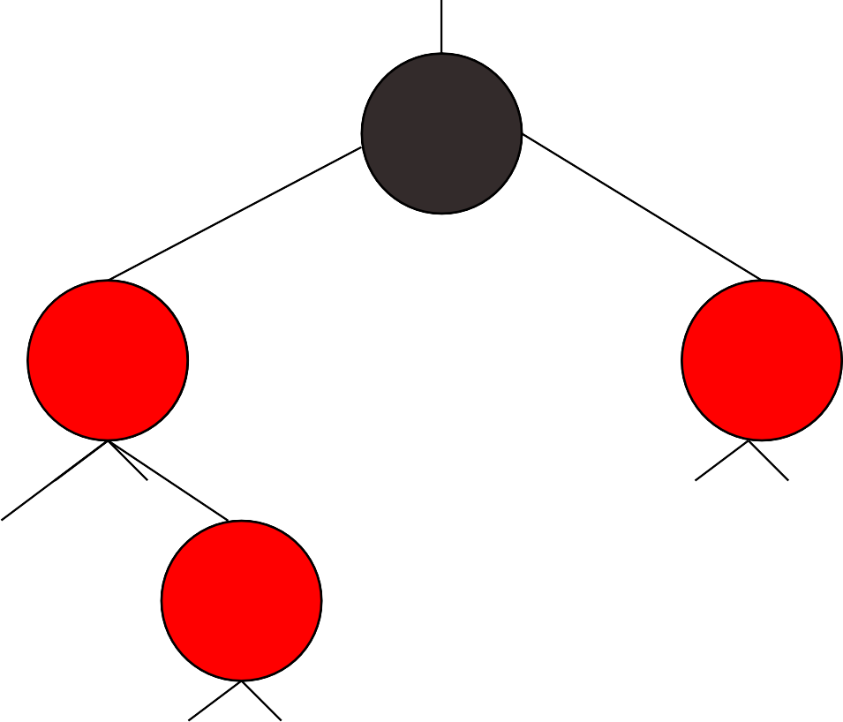
Algorithm: Insertion
We have detected a need for balance when z is red and his parent too.
If z has a red uncle: colour the parent and uncle black, and grandparent red.
z
Balanced trees: Red-black trees

Slide 99
Algorithm: Insertion
We have detected a need for balance when z is red and his parent too.
If z has a red uncle: colour the parent and uncle black, and grandparent red.
If z is a left child and has a black uncle: colour the parent black and the grandparent red, then rotateRight(z.parent.parent)
Balanced trees: Red-black trees

Slide 100
Algorithm: Insertion
We have detected a need for balance when z is red and his parent too.
If z has a red uncle: colour the parent and uncle black, and grandparent red.
Balanced trees: Red-black trees

Slide 101

Algorithm: Insertion
Let’s insert 4, 7, 12, 15, 3 and 5.
4
7
1
Double red violation!
It also shows it’s
unbalanced…
Balanced trees: Red-black trees

Slide 102
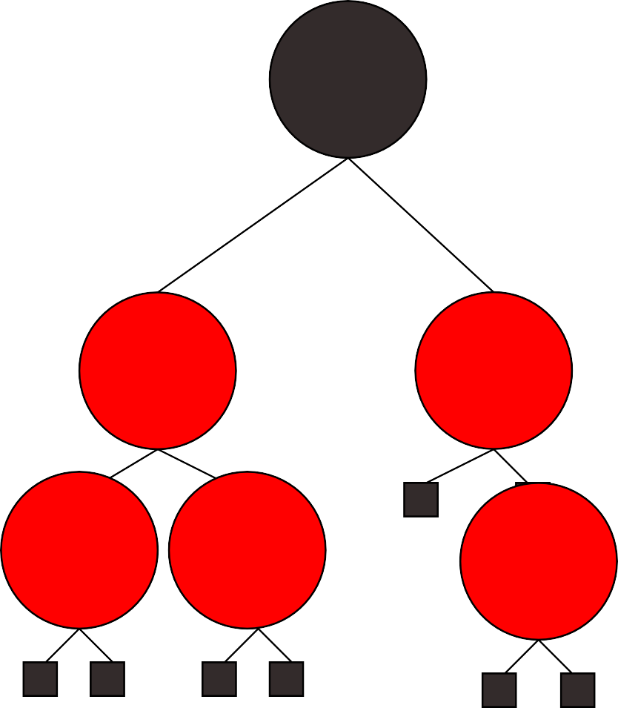
7
Algorithm: Insertion
Let’s insert 4, 7, 12, 15, 3 and 5.
4
12
15
What should we do?
Double red violation.
Nothing, no
double red.
3 5
We can’t have a better balance, and there is a red uncle…
Balanced trees: Red-black trees

Slide 103
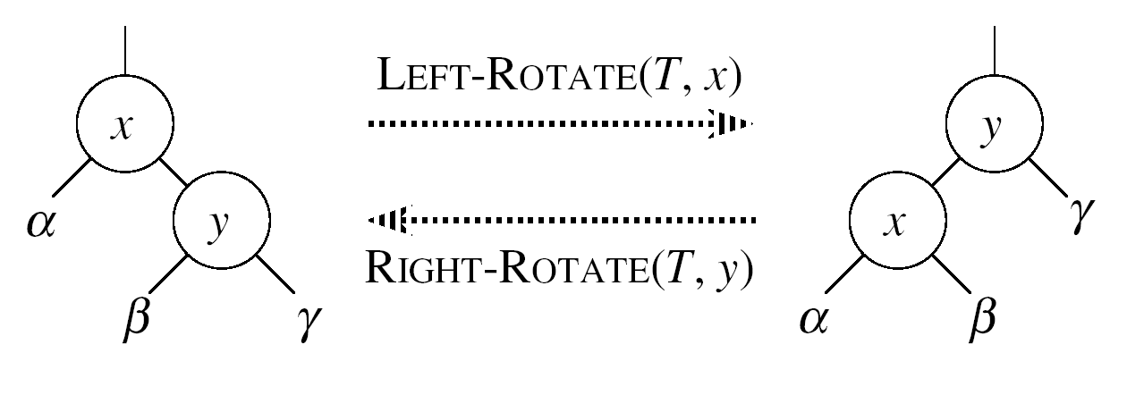
Left Rotations
Assumptions for a left rotation on a node x:
The right child of x (y) is not NIL
Idea:
Pivots around the link from x to y
Makes y the new root of the subtree
x becomes y’s left child
y’s left child becomes x’s right child

Slide 104
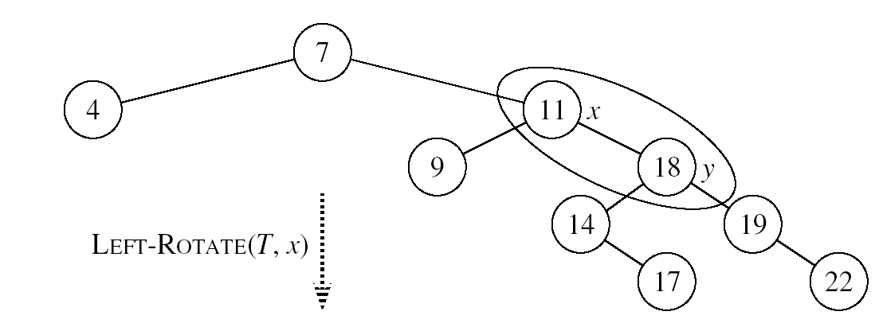
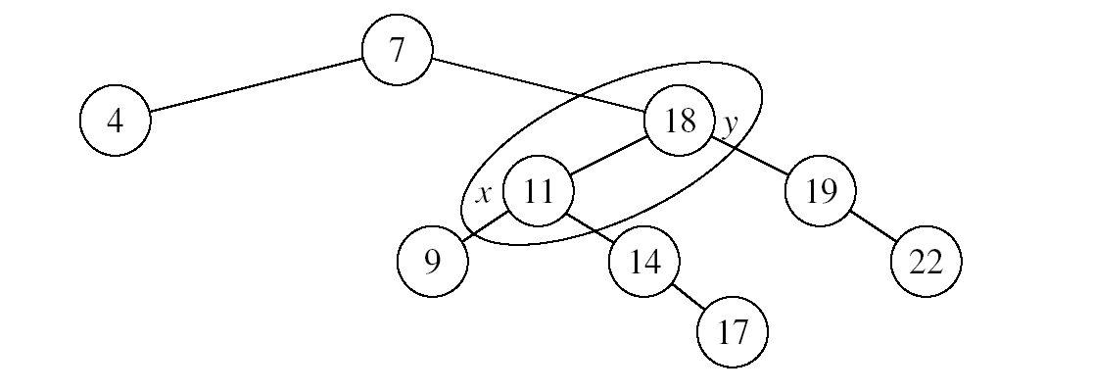
Example: LEFT-ROTATE

Slide 105
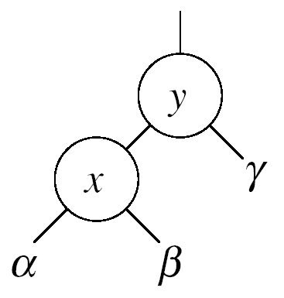
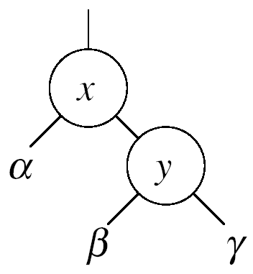


Right Rotations
Assumptions for a right rotation on a node x:
The left child of y (x) is not NIL
Idea:
Pivots around the link from y to x
Makes x the new root of the subtree
y becomes x’s right child
x’s right child becomes y’s left child

Slide 106
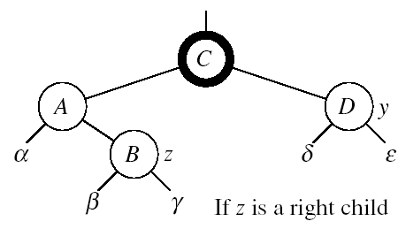


RB-INSERT-FIXUP – Case 1
z’s “uncle” (y) is red
Idea: (z is a right child)
p[p[z]] (z’s grandparent) must be black: z and p[z] are both red
Color p[z] black
Color y black
Color p[p[z]] red
z = p[p[z]]
Push the “red” violation up the tree

Slide 107



RB-INSERT-FIXUP – Case 1
z’s “uncle” (y) is red
Idea: (z is a left child)
p[p[z]] (z’s grandparent) must be black: z and p[z] are both red
color p[z] ← black
color y ← black
color p[p[z]] ← red
z = p[p[z]]
Push the “red” violation up the tree

Slide 108



RB-INSERT-FIXUP – Case 3
Case 3:
z’s “uncle” (y) is black
z is a left child
Idea:
color p[z] ← black
color p[p[z]] ← red
RIGHT-ROTATE(T, p[p[z]])
No longer have 2 reds in a row
p[z] is now black
Case 3

Slide 109

RB-INSERT-FIXUP – Case 2
Case 2:
z’s “uncle” (y) is black
z is a right child
Idea:
z ← p[z]
LEFT-ROTATE(T, z)
⇒ now z is a left child, and both z and p[z] are red ⇒ case 3
Case 2
Case 3

Slide 110
Example
Insert 4
11
Case 1
11
Case 2
2
14
2
14
y
1
7
7
z
15
1
15
5
8
y
5
8
z and p[z] are both red
z’s uncle y is red
z and p[z] are both red
z’s uncle y is black
z is a right child
z
4
4
11
7
Case 3
z
7
14
y
2
11
z
2
8
15
1
5
8
14
1
5
z and p[z] are red
z’s uncle y is black
z is a left child
4
15
4

Slide 111
Deletion
Deletion, like insertion, should preserve all the RB properties.
The properties that may be violated depends on the color of the deleted node.
Red – OK. Why?
Black?
Steps:
Do regular BST deletion.
Fix any violations of RB properties that may result.

